Slide 1


Finlora Fraud Risk-Scoring
From raw transactions to a deployed, explainable fraud model
Stakeholder Presentation
Data Science & Risk Engineering

Slide 2






EXECUTIVE SUMMARY
A deployed, explainable model that catches 67% of fraud at 70% precision
The problem.
01
– Finlora needs a fraud probability, not a pass/fail rule, to triage 126,000 transactions a year at a 2.66% fraud rate — too rare for accuracy to
mean anything.
The approach.
02
– A 10-notebook pipeline — clean, explore, split, engineer, select, optimize (4 rounds), explain, evaluate — each decision made on validation
The result.
03
– The deployed model catches 67.4% of fraud at 69.75% precision on that untouched test set (PR-AUC 0.725) — a deliberate balance point,
not a default.
The honest limit.
04
– 70% precision and 70% recall together is not achievable with today's features, checked across 6 models — documented, not hidden, with a
05
Live now.
– Scoring, dashboard, and monitoring are running today: https://finlora-risk-scoring-ngozi.streamlit.app/
Finlora Fraud Risk-Scoring
1

Slide 3


01
The Problem & The Data
Why a probability score beats a pass/fail rule

Slide 4




THE PROBLEM
From a pass/fail rule to a risk score
› Finlora's transaction-monitoring model needs to assign every
payment a fraud probability — not a binary pass/fail — so
downstream teams can triage by risk.
SCOPE
› 126,000 transactions, 7,200 accounts
› Fraud is rare (2.66% of transactions) and costly to miss, but
flagging too much legitimate activity erodes customer trust and
burns manual-review capacity.
› 5 countries, 15 merchant categories
› 10 notebooks: clean → explore → split → engineer
→ select → optimize → explain → evaluate
› Goal: a model that ranks transactions by risk well enough to
support a real operating decision — approve, step-up
authentication, or hold for review — and an app that puts that
score in front of the people who need it.
› A live Streamlit app: scoring, dashboard,
observability
Finlora Fraud Risk-Scoring
3

Slide 5




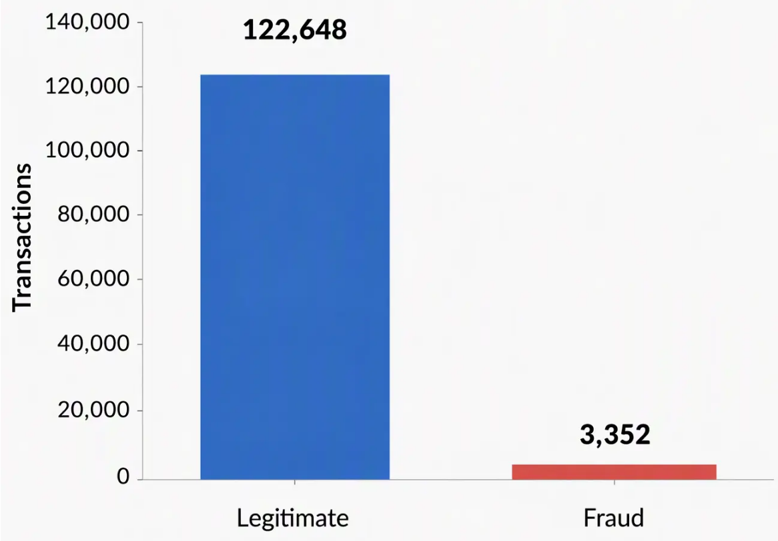


THE DATA
126,000 transactions, a 2.66% fraud rate
2.66% fraud rate — 126,000 transactions
Two source tables merged on account_id: transaction-
level detail and account-level attributes (KYC tier, account
type, home country).
This imbalance is the central fact of the whole project:
accuracy is meaningless here (predicting "not fraud" for
everyone scores ~97.3%), so precision, recall, and F1 on the
fraud class drive every decision.
Every model and threshold choice from here on is judged
against this baseline rate.
Finlora Fraud Risk-Scoring
4

Slide 6

02
Preparing the Data
Cleaning, exploration, and feature engineering

Slide 7










DATA CLEANING
Fixing what's broken, flagging what's ambiguous
Missing values — structural, not random
– merchant_name missing for 22.7% of rows (no merchant on ATM/transfer transactions) → filled "Unknown"
– device_id / is_new_device missing for the exact same 11.4% of rows (channels with no device context) → filled explicitly
Duplicates — none found
– 0 fully duplicated rows, 0 repeated transaction_id across 126,000 rows
Invalid amounts — flagged, not dropped
– ~400 rows (0.3%) carry a negative amount or avg_transaction_amount_30d — consistent with refunds, not fraud (their fraud rate
matches the baseline) — kept and flagged via has_invalid_amount
Finlora Fraud Risk-Scoring
5

Slide 8



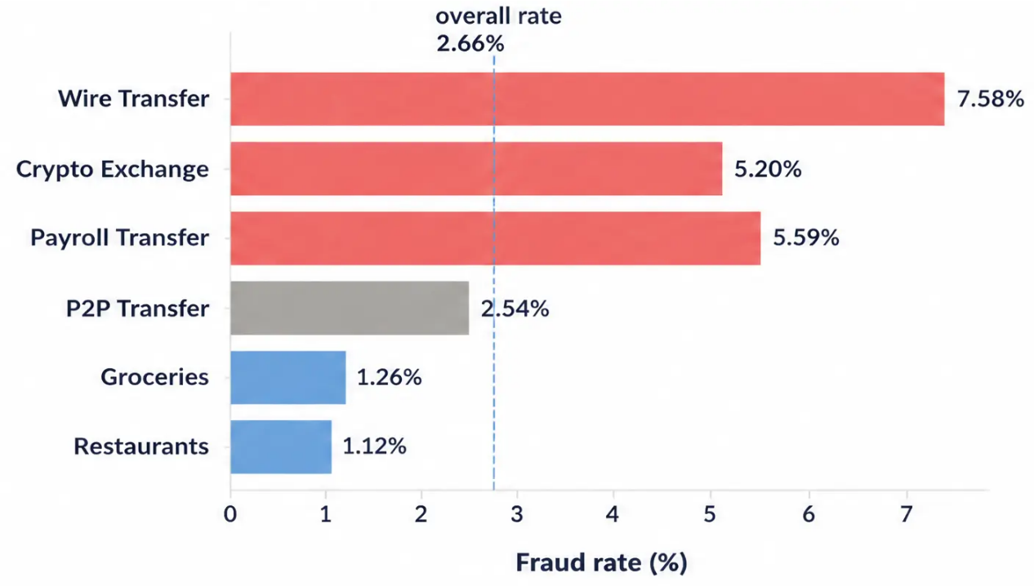


EXPLORATORY ANALYSIS
Where the fraud signal actually lives
Merchant category: the widest categorical spread
> transaction_velocity_1h is the single strongest signal:
38.2% of fraud has a repeat transaction within the hour vs.
just 0.09% of legitimate activity — a >400x gap.
> amount_to_avg_ratio is next: fraud is ~6x an account's
own average transaction size vs. ~1x for legitimate activity.
> Business accounts, low KYC tiers, new devices, and cross-
border transactions all run meaningfully hotter than
baseline.
> day_of_week and geography carry little independent
signal once the above are accounted for.
BOTTOM LINE
Fraud concentrates in a few identifiable segments — it isn't spread evenly
across the transaction population.
Finlora Fraud Risk-Scoring
6

Slide 9










FEATURE ENGINEERING
Four new features, one leakage risk removed
NEW FEATURES — BUILT FROM TRAINING DATA ONLY
LEAKAGE CHECK
> status (Completed/Declined/Reversed) looks like an
ordinary field — but "Reversed" is often the
consequence of fraud being confirmed later, not
something known at scoring time.
hour_bucket: Night / Morning / Afternoon / Evening
is_weekend: coarser than day_of_week alone
amount_log: log1p(amount) — compresses the heavy
right skew
> Fraud rate: 1.7% for Completed/Declined vs. 33.3%
for Reversed — unmistakable leakage.
velocity_flag: an explicit 0/1 version of the
strongest signal
> status and all row identifiers are excluded from the
model's feature set.
Finlora Fraud Risk-Scoring
7

Slide 10

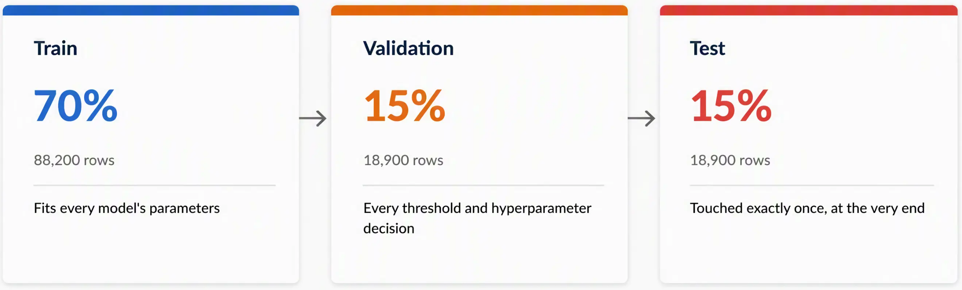
TRAIN / VALIDATION / TEST SPLIT
One split, touched in a strict order
BOTTOM LINE
Stratified on is_fraud at every step — all three sets land within a few hundredths of a point of the 2.66% baseline rate, with zero
transaction_id overlap between them.
Finlora Fraud Risk-Scoring
8

Slide 11

03
Building the Model
Selection, then four rounds of deliberate optimization

Slide 12









MODEL SELECTION
Three candidates, compared on validation
Model
ROC-AUC
PR-AUC
Logistic Regression
0.938
0.620
Random Forest
0.944
0.652
Gradient Boosting
0.945
0.689
★ Selected
BOTTOM LINE
PR-AUC — not ROC-AUC — is the deciding metric: at a 2.66% base rate, ROC-AUC is dominated by the huge legitimate class and
barely separates the candidates.
Finlora Fraud Risk-Scoring
9

Slide 13



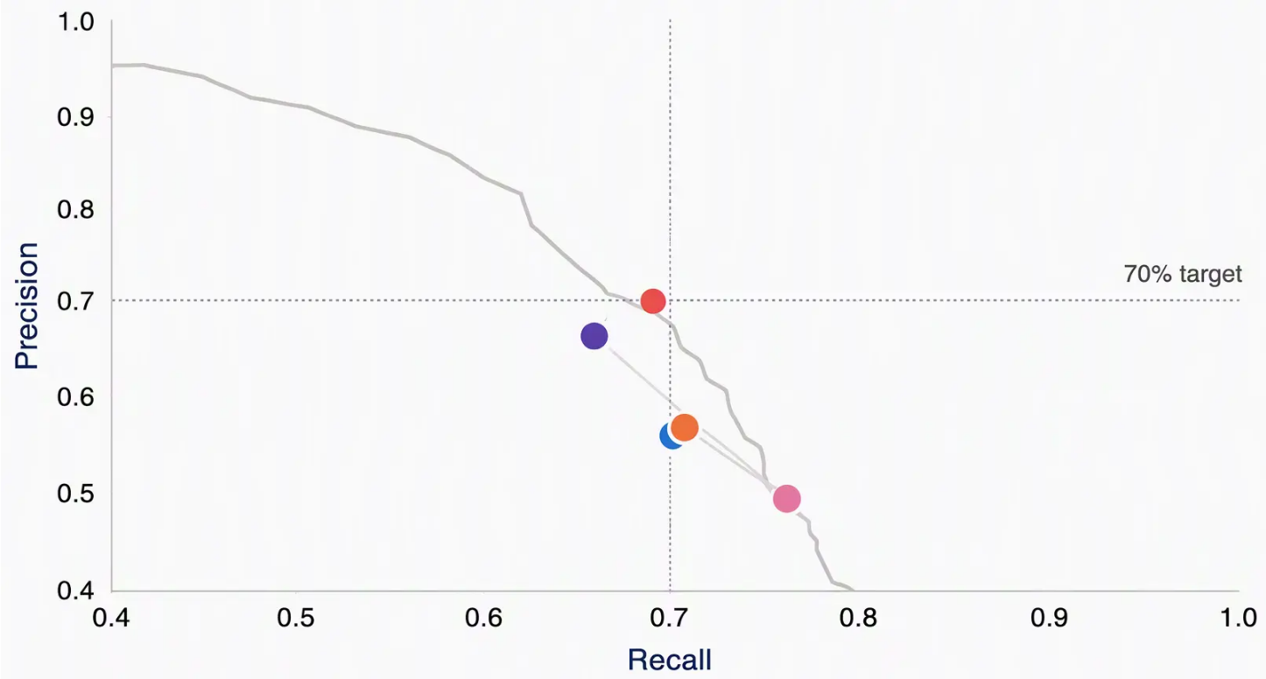


THE OPTIMIZATION JOURNEY
Four deliberate rounds, one metric each
The optimization journey
1. Baseline
– 70.2% recall / 55.9% precision
2. F1-optimized
– Recall floor + best F1: both metrics improve →
70.8% / 56.8%
3. Recall-first
– F2-scored tuning: 76.1% recall, precision falls
to 49.4%
4. Balanced (deployed)
– PR-AUC-tuned HistGB: 66.0% / 66.0% —
closest to 70/70
1. Baseline
4. Balanced (deployed)
2. F1-optimized
5. Final (test set)
5. Final (test set)
3. Recall-optimized
Test PR curve (final model)
Finlora Fraud Risk-Scoring
10

Slide 14






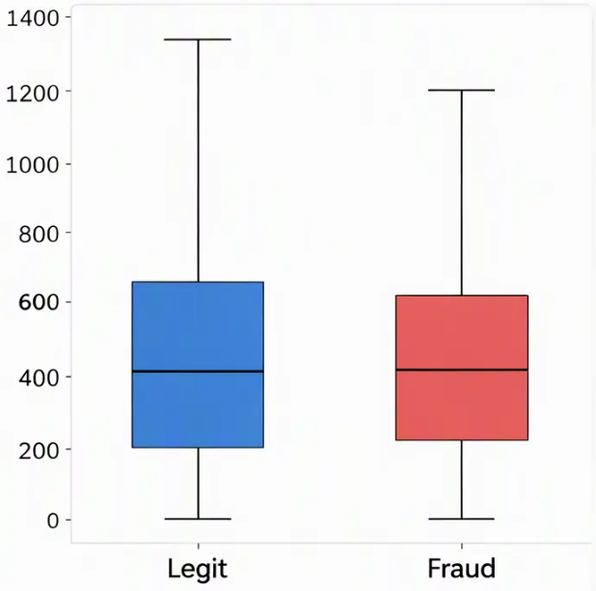
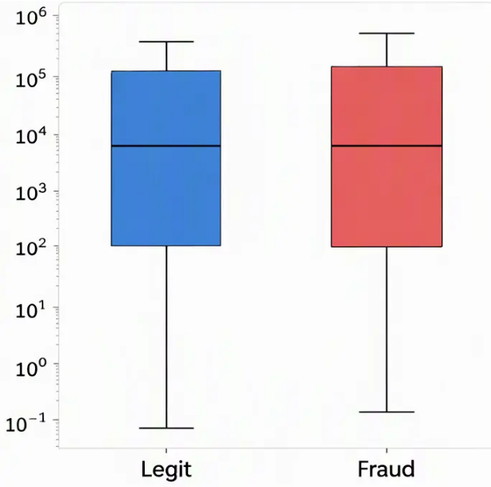

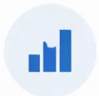


AN HONEST LIMIT
Why 70% precision and 70% recall together isn't reachable
Most numeric features overlap heavily between classes
› Checked empirically across 6 models — 3 baseline
candidates, a stronger algorithm, extra engineered
features, and a PR-AUC-tuned final version — none clear
both 70% marks at once.
account_age_days
avg_transaction_amount_30d
› Why: most numeric features overlap heavily between
fraud and legitimate transactions — only
transaction_velocity_1h cleanly separates the classes.
› Closing this gap further likely needs new signal (device
fingerprinting, network reputation), not more tuning on
today's features.
Finlora Fraud Risk-Scoring
11

Slide 15



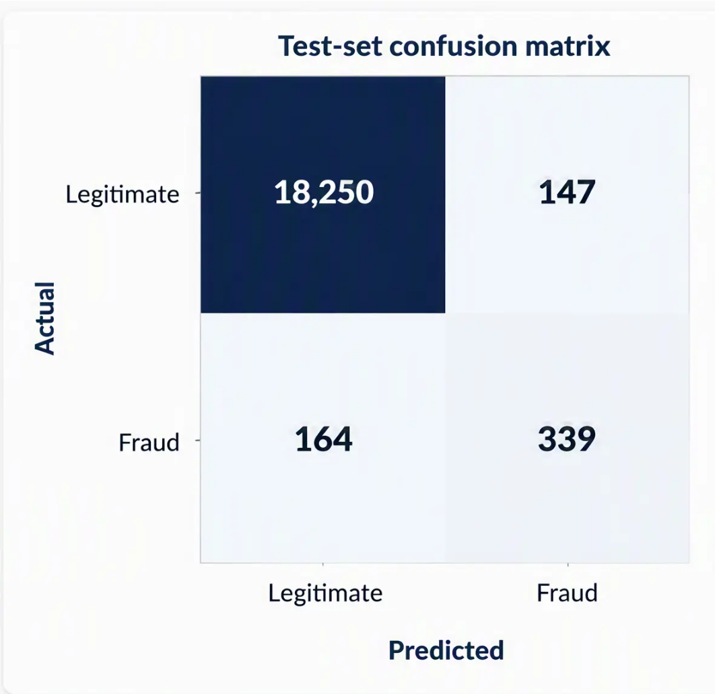
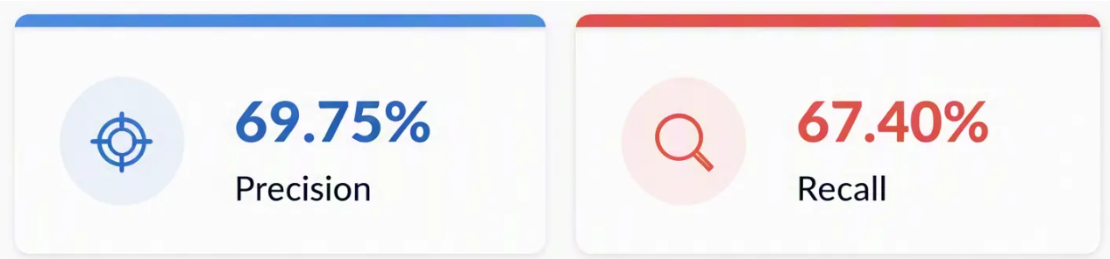
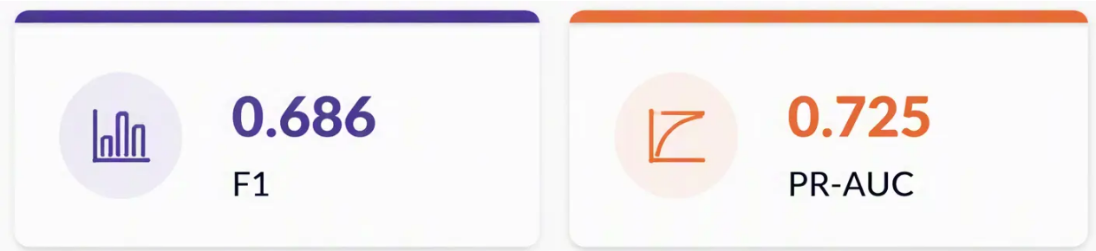
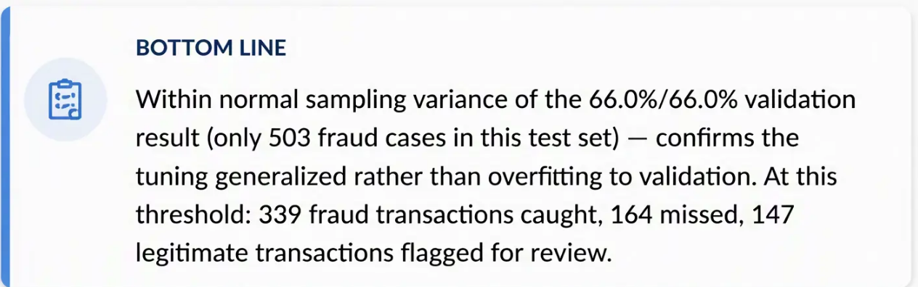
FINAL PERFORMANCE
The test set's one-time, unbiased check
Finlora Fraud Risk-Scoring
12

Slide 16


04
Explainability & Trust
What the model relies on, transaction by transaction

Slide 17

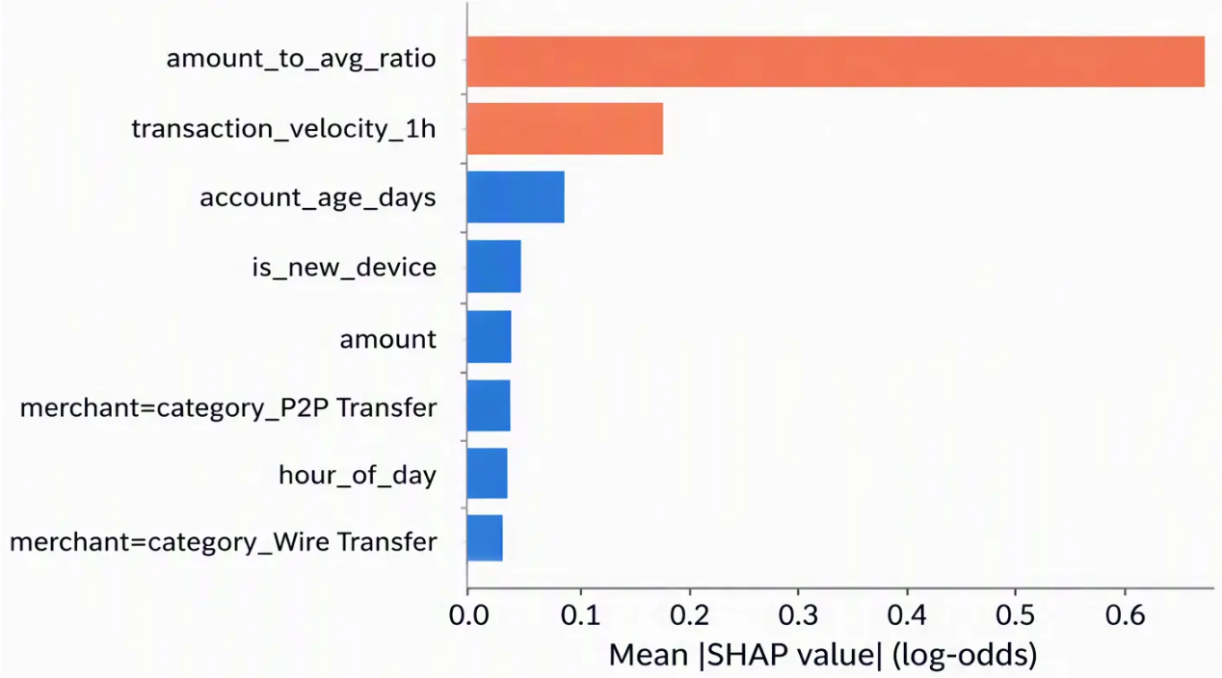

MODEL EXPLAINABILITY (SHAP)
What the model actually relies on
What the model actually relies on
amount_to_avg_ratio dominates — 4x higher than
transaction_velocity_1h, reversing the raw-correlation
ranking from the EDA.
Why: velocity is near-binary (one split captures it); the
continuous, long-tailed ratio accumulates influence
across many tree splits.
BOTTOM LINE
A missed fraud transaction had a normal-looking amount_to_avg_ratio — explaining exactly why the model's top feature failed to flag it.
Finlora Fraud Risk-Scoring
13

Slide 18

05
Deployment
A live scoring app, a dashboard, and ongoing monitoring

Slide 19






THE STREAMLIT APP
Three pages, one model
Home
Dashboard
Observability
Score one transaction or a batch CSV;
every prediction is logged.
The optimization journey, SHAP
drivers, confusion matrix, and the
70/70 story — built for a stakeholder
audience.
ROC/PR curves, live-traffic monitoring,
and PSI-based drift detection against
the training baseline.
Live app: https://finlora-risk-scoring-ngozi.streamlit.app/
Finlora Fraud Risk-Scoring
14

Slide 20


06
Recommendation & Next Steps
Where this stands, and what would move it forward

Slide 21









RECOMMENDATION
Deploy the balanced model; tier by risk, not by a single cutoff
› Serve the precision/recall-balanced HistGradientBoostingClassifier
at threshold 0.915 — the closest achievable point to equal precision
and recall on this data.
DEPLOY
› Use the score as a risk tier, not a block/allow switch:
Low → auto-approve, Medium → step-up authentication, High →
manual review — this spends manual-review capacity where it matters
most rather than on a single hard cutoff.
TIER BY RISK
› Watch the Observability page's drift metrics on a regular cadence; retrain
when PSI crosses 0.25 on a key feature or when enough new labeled
fraud accumulates.
MONITOR
Finlora Fraud Risk-Scoring
15

Slide 22





LIMITATIONS & NEXT STEPS
What would move the ceiling
Known limitations
Recommended next steps
— Row-level train/test split, not account-level —
metrics reflect within-account generalization, not
entirely unseen accounts
— New data signals — device fingerprinting, IP/network
reputation — are the most promising lever to break
the current precision/recall ceiling
— 70% precision and 70% recall together is not
reachable with today's features
— An account-held-out evaluation (GroupShuffleSplit)
before a production go/no-go
— A scheduled retrain cadence, triggered by the
drift monitoring already built
Finlora Fraud Risk-Scoring
16

Slide 23


Thank you
Questions & discussion
Try the live app: https://finlora-risk-scoring-ngozi.streamlit.app/

